Slide 1

Sri Sai Institute of Technology and Science(SSITS)
Approved by AICTE, New Delhi and Affiliated to JNTUA, Ananthapuram ,Rayachoty, Annamayya dist -516270
Project Review
on
Training and Development Management

Slide 2
Presented by:
G Manasaveena
V Dasaradha
P
Under the Guidence
of
Mr. Exson

Slide 3
CONTENTS
Abstract
Introduction
Project Description
System Requireenmts
Flow Chat
Implementation
Programming Language
Framework
Source code
Execution Process
Conclusion

Slide 4
ABSTRACT
Employee training is distinct from management development. Training is a short-term process utilizing a systematic and organized procedure by which non-managerial personnellearn technical knowledge and skills for a definite purpose. It refers to instructions in technicaland mechanical operations like operation of a machine. It is designed primarily of non-managers.
It is for a short duration and for a specific job-related purpose. On the other hand,development is a long-term educational process utilizing a systematic and organized procedure by which managerial personnel learn conceptual and theoretical educational concepts and it isdesigned for managers. It involves broader education and its purpose is long-term development.
In thewords of Campbell, “Training courses are typically designed for a short-term, stated set purpose, such as the operation of some piece(s) of machinery while development involves a broader education for long-term purposes.”

Slide 5
Introduction
This project will focus on employee performance, career development, and the organization’s effectiveness. The training program will be geared towards solving performance issues, offering career development for the staff, improving overall organization effectiveness, and yielding a return on investments for the organization.
ote User

Slide 6
PROJECT DESCRIPTION
The Training and Development project is an activity aimed at helping the company improve its operations and processes. In other words, it takes the form of workshops, seminars, lectures, or programs designed to help employees learn new skills and gain valuable knowledge about their work. It can also be thought of as a process wherein the organization identifies its training needs and creates ways to meet them.

Slide 7
Investing in the training and development of employees provides a competitive advantage for our organization and benefits the individual who is diligent about their career. If a company is not caring about their employees, then the employees will feel that their organization does not care about them (Garger, 1999). The Training and Development project will provide a resource for employees, supervisors, and managers to develop leadership skills, communication skills and knowledge of the new technologies necessary for success within their respective roles.

Slide 8
SYSTEM REQUIREMENTS
H/W System Configuration:-
Processor - Pentium –IV
RAM - 4 GB (min)
Hard Disk - 20 GB
Key Board - Standard Windows Keyboard
Mouse - Two or Three Button Mouse
Monitor - SVGA

Slide 9
Software Requirements:
Operating system : Windows 10 Ultimate.
Coding Language : Python.
Front-End : Python.
Back-End : Django-ORM
Designing : Html, css, javascript.
Data Base : MySQL (WAMP Server).

Slide 10
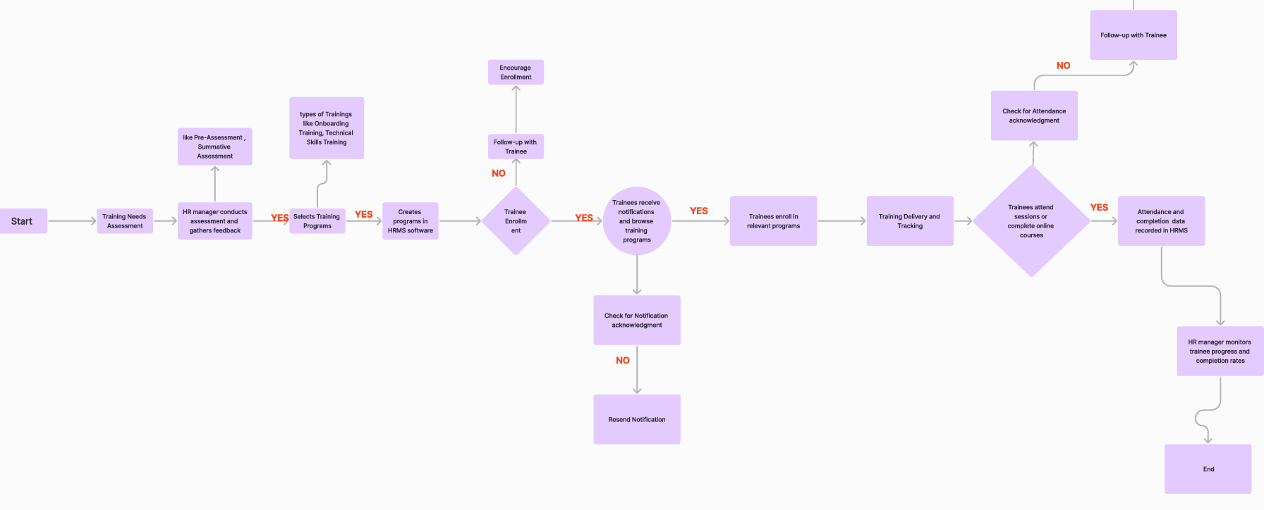
Flow Chart

Slide 11
Implementation
The proposed work is implemented in python with libraries Django in Back-end.
The proposed work is implemented with Html and CSS in Front-end.

Slide 12
PROGRAMMING LANGUAGES
HTML: Hyper Text Markup Language or HTML is the standard markup language for documents designed to be displayed in a web browser. It defines the content and structure of web content. "Hypertext" refers to links that connect web pages to one another, either within a single website or between websites. Links are a fundamental aspect of the Web.
CSS: Cascading Style Sheets (CSS) is a style sheet language used for specifying the presentation and styling of a document written in a markup language such as HTML or XML.CSS is a cornerstone technology of the World Wide Web, alongside HTML and JavaScript.

Slide 13
Python: Python is a high-level, general-purpose programming language. Its design philosophy emphasizes code readability with the use of significant indentation. Python is dynamically typed and garbage-collected. It supports multiple programming paradigms, including structured (particularly procedural), object-oriented and functional programming.

Slide 14
Framework Libraries
Django: Django is a high level Python web framework that encourages rapid development and clean, pragmatic design.

Slide 15
Prediction Code
body {
font-family: Arial, sans-serif;
margin: 0;
padding: 0;
background-color: #f2f2f2;
}
/* Navigation styling */
nav {
background-color: #333;
color: #fff;
text-align: center;
padding: 20px 0;

Slide 16
TEST CASES
TEST CASE – 1 :Test case for Empty Login Field.
Test Case Name | Empty login Fields Testing
Description | In the login screen if the username and password fields are empty.
Output | Login fails then showing an alert box asking to please fill out the field.
TEST CASE – 2 :Test case for Wrong Login Fields.
Test Case Name | Wrong login Fields Testing
Description | In the login screen if the username and password fields are empty.
Output | Login fails, then it show empty fields.

Slide 17

EXECUTION PROCESS

Slide 18
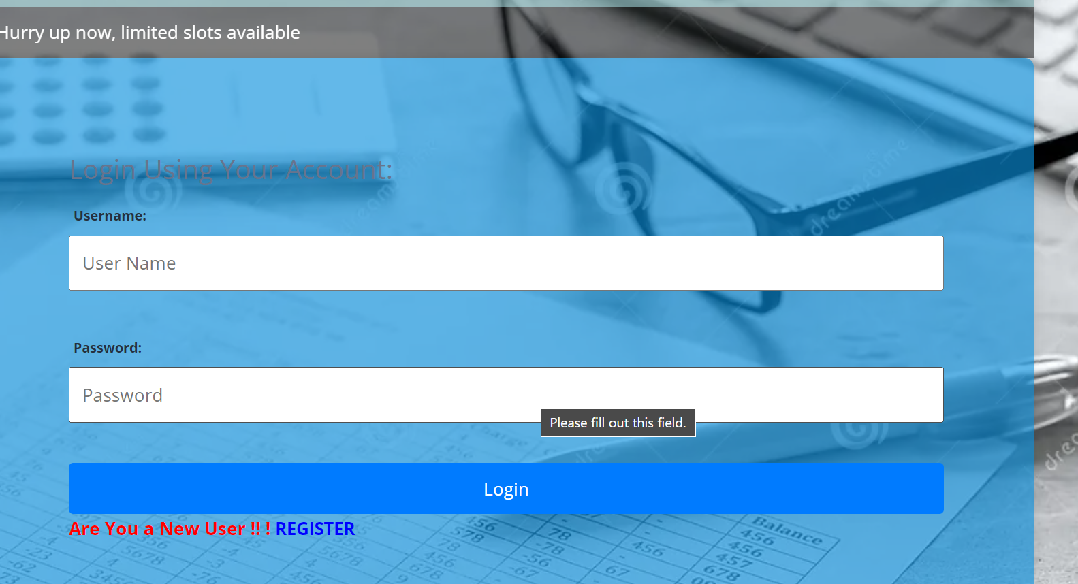

Slide 19
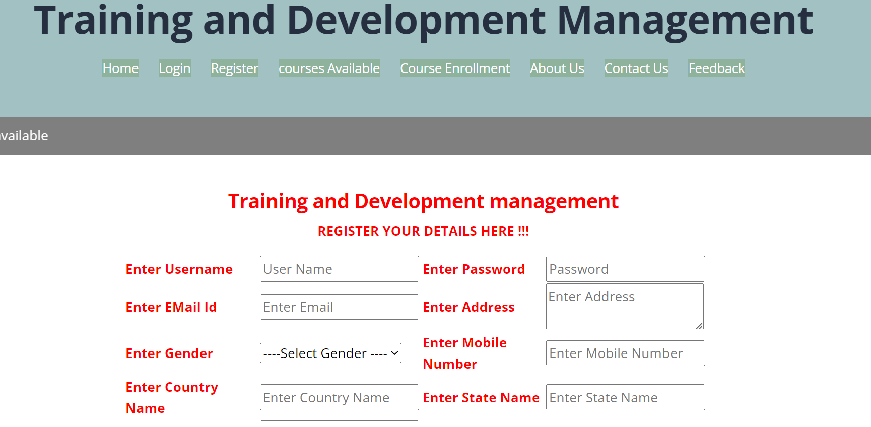

Slide 20
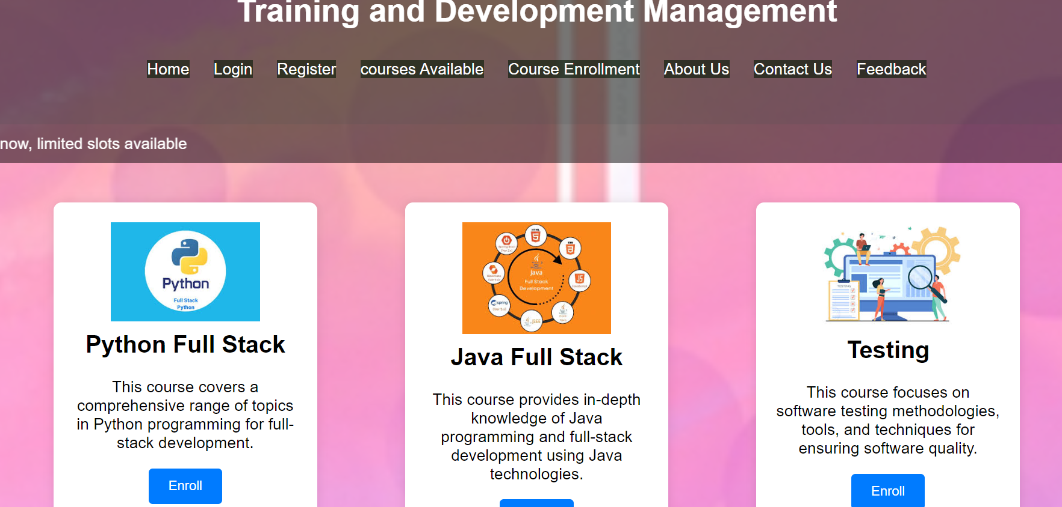

Slide 21
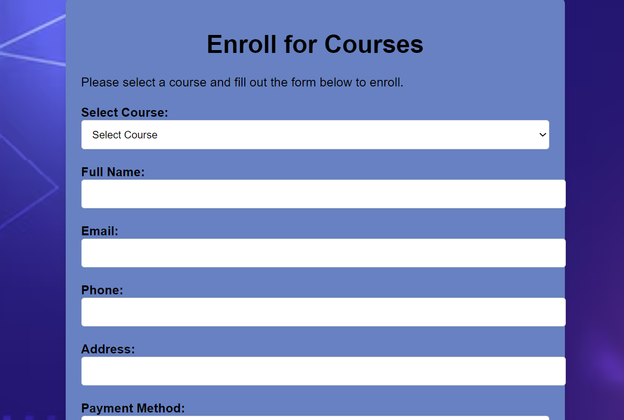

Slide 22
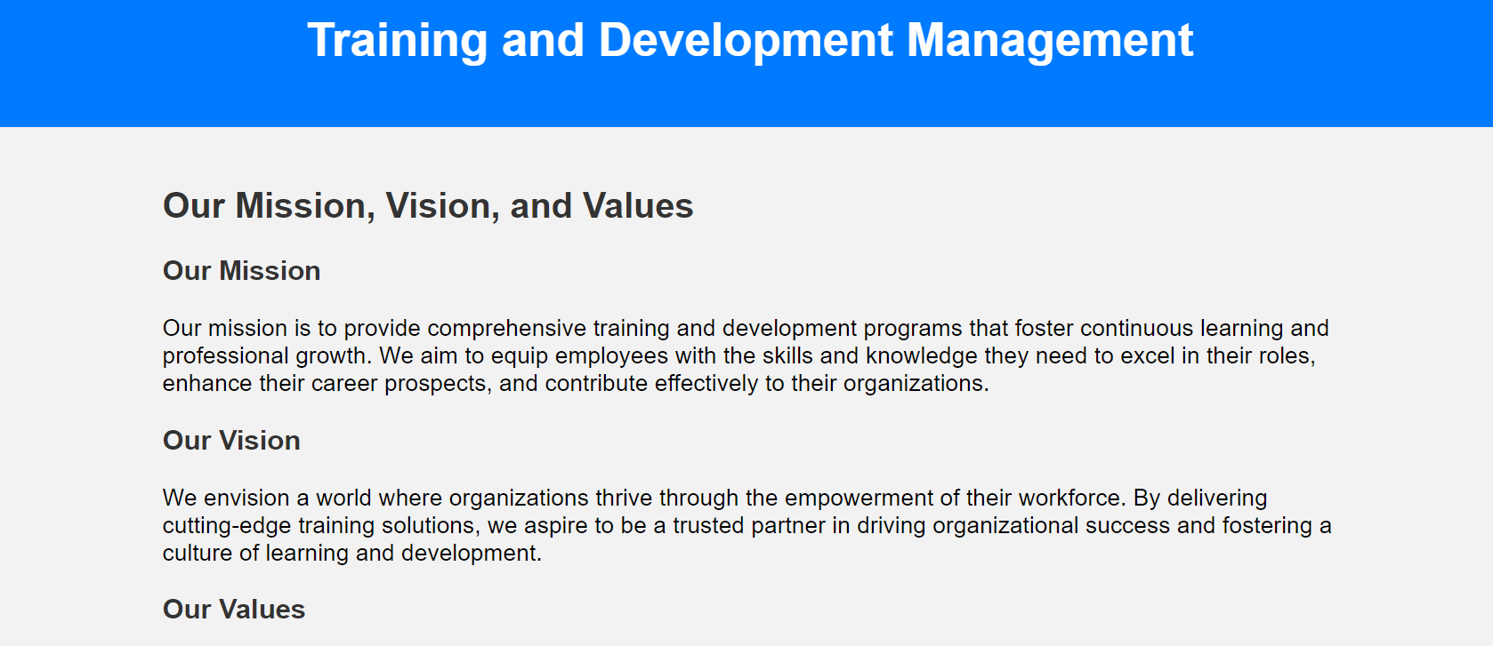

Slide 23
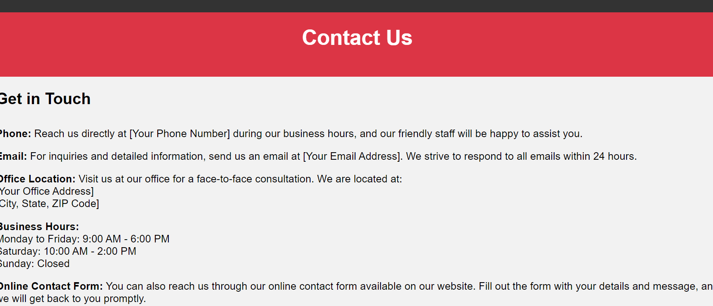

Slide 24
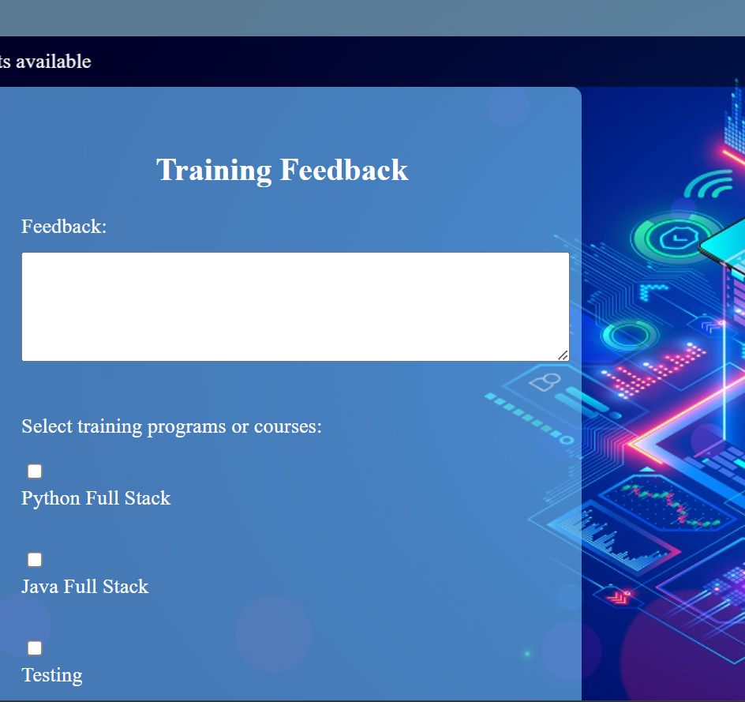

Slide 25
CONCLUSION
In conclusion, this training and development project has provided valuable insights into [brief summary of project objectives]. Through rigorous research, analysis, and implementation, several key conclusions have emerged:
Effectiveness of Training Programs: Our analysis indicates that the training programs implemented have significantly improved [specific areas, skills, or behaviors targeted]. This is evidenced by [provide evidence or data points].
Employee Engagement and Satisfaction: Feedback gathered from participants indicates a high level of satisfaction and engagement with the training initiatives. This suggests that our approach effectively catered to the needs and preferences of our employees.

Slide 26


